Slide 1
Chapter 2
Bits, Data Types, and Operations

Slide 2
How do we represent data in a computer?
At the lowest level, a computer is an electronic machine.
works by controlling the flow of electrons
Easy to recognize two conditions:
presence of a voltage – we’ll call this state “1”
absence of a voltage – we’ll call this state “0”
Could base state on value of voltage,
but control and detection circuits more complex.
compare turning on a light switch to measuring or regulating voltage

Slide 3
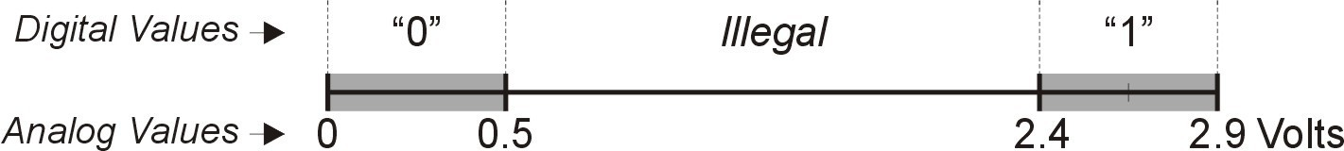
Computer is a binary digital system.
Digital system:
finite number of symbols
Binary (base two) system:
has two states: 0 and 1
Basic unit of information is the binary digit, or bit. Values with more than two states require multiple bits.
A collection of two bits has four possible states: 00, 01, 10, 11
A collection of three bits has eight possible states: 000, 001, 010, 011, 100, 101, 110, 111
A collection of n bits has 2^{n} possible states.

Slide 4
What kinds of data do we need to represent?
Numbers – signed, unsigned, integers, floating point, complex, rational, irrational, …
Text – characters, strings, …
Images – pixels, colors, shapes, …
Sound
Logical – true, false
Instructions
…
Data type:
representation and operations within the computer
We’ll start with numbers…

Slide 5
Unsigned Integers
Non-positional notation
could represent a number (“5”) with a string of ones (“11111”)
problems?
Weighted positional notation
like decimal numbers: “329”
“3” is worth 300, because of its position, while “9” is only worth 9
329
10² 10¹ 10⁰
most
101
₂2 ₂1 ₂0
least
significant
significant
3x100 + 2x10 + 9x1 = 329
1x4 + 0x2 + 1x1 = 5

Slide 6
Unsigned Integers (cont.)
An n-bit unsigned integer represents 2^{n} values: from 0 to 2^{n}-1.
₂2 | ₂1 | ₂0
0 | 0 | 0 | 0
0 | 0 | 1 | 1
0 | 1 | 0 | 2
0 | 1 | 1 | 3
1 | 0 | 0 | 4
1 | 0 | 1 | 5
1 | 1 | 0 | 6
1 | 1 | 1 | 7

Slide 7
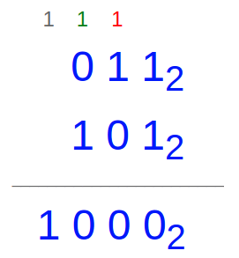
Unsigned Binary Arithmetic
Base-2 addition – just like base-10!
add from right to left, propagating carry
Subtraction, multiplication, division,…

Slide 8
Signed Integers (not two's complement yet)
With n bits, we have 2^{n} distinct values.
assign about half to positive integers (1 through 2^{n-1} - 1) and about half to negative (-2^{n-1} - 1 through -1)
that leaves two values: one for 0, and one extra
Positive integers
just like unsigned – zero in most significant (MS) bit
00101 = 5
Negative integers
sign-magnitude – set MS bit to show negative, other bits are the same as unsigned
10101 = -5
one’s complement – flip every bit to represent negative
11010 = -5
in either case, MS bit indicates sign: 0=positive, 1=negative

Slide 9
Two’s Complement
Problems with sign-magnitude and 1’s complement
two representations of zero (+0 and –0)
arithmetic circuits are complex
How to add two sign-magnitude numbers?
– e.g., try 2 + (-3)
How to add to one’s complement numbers?
– e.g., try 4 + (-3)
Two’s complement representation developed to make circuits easy for arithmetic.
for each positive number (X), assign value to its negative (-X), such that X + (-X) = 0 with “normal” addition, ignoring carry out
00101 | (5) |  | 01001 | (9)
+ 11011 | (-5) | + |  | (-9)
00000 | (0) |  | 00000 | (0)

Slide 10
Two’s Complement Representation
If number is positive or zero,
normal binary representation, zeroes in upper bit(s)
If number is negative,
start with positive number
flip every bit (i.e., take the one’s complement)
then add one
 | 00101 | (5)
 | 11010 | (1’s comp)
+ | 1
 | 11011 | (-5)

Slide 11
Two’s Complement Shortcut
To take the two’s complement of a number:
copy bits from right to left until (and including) the first “1”
flip remaining bits to the left
011010000
100101111 (1’s comp)
1
100110000
011010000
(flip) (copy)
100110000
+

Slide 12
Two’s Complement Signed Integers
MS bit is sign bit – it has weight –2^{n-1}.
Range of an n-bit number: -2^{n-1} through 2^{n-1} – 1.
The most negative number (-2^{n-1}) has no positive counterpart.
-2³ 2² 2¹ 2⁰ -2³ 2² 2¹ 2⁰
0 | 0 | 0 | 0 | 0 | 1 | 0 | 0 | 0 | -8
0 | 0 | 0 | 1 | 1 | 1 | 0 | 0 | 1 | -7
0 | 0 | 1 | 0 | 2 | 1 | 0 | 1 | 0 | -6
0 | 0 | 1 | 1 | 3 | 1 | 0 | 1 | 1 | -5
0 | 1 | 0 | 0 | 4 | 1 | 1 | 0 | 0 | -4
0 | 1 | 0 | 1 | 5 | 1 | 1 | 0 | 1 | -3
0 | 1 | 1 | 0 | 6 | 1 | 1 | 1 | 0 | -2
0 | 1 | 1 | 1 | 7 | 1 | 1 | 1 | 1 | -1

Slide 13
Converting Binary (2’s C) to Decimal
If leading bit is one, take two’s complement to get a positive number.
Add powers of 2 that have “1” in the corresponding bit positions.
If original number was negative, add a minus sign.
n
₂n
0 1
1 2
2 4
3 8
4 16
5 32
6 64
7 128
8 256
9 512
10 1024
X = 01101000_{two}
= 2⁶+2⁵+2³ = 64+32+8
= 104_{ten}
Assuming 8-bit 2’s complement numbers.

Slide 14
More Examples
X = 00100111_{two}
= 2⁵+2²+2¹+2⁰ = 32+4+2+1
= 39_{ten}
n
₂n
0 1
1 2
2 4
3 8
4 16
5 32
6 64
7 128
8 256
9 512
10 1024
X = 11100110_{two}
-X = 00011010
= 2⁴+2³+2¹ = 16+8+2
= 26_{ten}
X = -26_{ten}
Assuming 8-bit 2’s complement numbers.

Slide 15
Converting Decimal to Binary (2’s C)
First Method: Division
Find magnitude of decimal number. (Always positive.)
Divide by two – remainder is least significant bit.
Keep dividing by two until answer is zero, writing remainders from right to left.
Append a zero as the MS bit;
if original number was negative, take two’s complement.
X = 104_{ten}
104/2 | = | 52 r0 | bit 0
52/2 | = | 26 r0 | bit 1
26/2 | = | 13 r0 | bit 2
13/2 | = | 6 r1 | bit 3
6/2 | = | 3 r0 | bit 4
3/2 | = | 1 r1 | bit 5
X = 01101000_{two}
1/2
=
0 r1
bit 6

Slide 16
Converting Decimal to Binary (2’s C)
₂n
n
Second Method: Subtract Powers of Two
0 1
1 2
2 4
3 8
4 16
5 32
6 64
7 128
8 256
9 512
10 1024
Find magnitude of decimal number.
Subtract largest power of two less than or equal to number.
Put a one in the corresponding bit position.
Keep subtracting until result is zero.
Append a zero as MS bit;
if original was negative, take two’s complement.
X = 104_{ten}
104 - 64 = 40
40 - 32 = 8
8 - 8 = 0
bit 6
bit 5
bit 3
X = 01101000_{two}
2-16

Slide 17
Operations: Arithmetic and Logical
Recall:
a data type includes representation and operations.
We now have a good representation for signed integers, so let’s look at some arithmetic operations:
Addition
Subtraction
Sign Extension
We’ll also look at overflow conditions for addition.
Multiplication, division, etc., can be built from these basic operations.
Logical operations are also useful:
AND
OR
NOT

Slide 18
Addition
As we’ve discussed, 2’s comp. addition is just binary addition.
assume all integers have the same number of bits
ignore carry out
for now, assume that sum fits in n-bit 2’s comp. representation
 | 01101000 | (104) |  | 11110110 (-10)
+ | 11110000 | (-16) | + | (-9)
 | 01011000 | (88) |  | (-19)
Assuming 8-bit 2’s complement numbers.

Slide 19
Subtraction
Negate subtrahend (2nd no.) and add.
assume all integers have the same number of bits
ignore carry out
for now, assume that difference fits in n-bit 2’s comp. representation
 | 01101000 | (104) |  | 11110110 (-10)
- | 00010000 | (16) | - | (-9)
 | 01101000 | (104) |  | 11110110 (-10)
+ | 11110000 | (-16) | + | (9)
 | 01011000 | (88) |  | (-1)
Assuming 8-bit 2’s complement numbers.

Slide 20
Sign Extension
To add two numbers, we must represent them with the same number of bits.
If we just pad with zeroes on the left:
4-bit |  | 8-bit
0100 | (4) | 00000100 | (still 4)
1100 | (-4) | 00001100 | (12, not -4)
Instead, replicate the MS bit -- the sign bit:
4-bit |  | 8-bit
0100 | (4) | 00000100 | (still 4)
1100 | (-4) | 11111100 | (still -4)

Slide 21
If 2 Two's Complement numbers are added, and they both have the same sign (both positive or both negative), then overflow occurs if and only if the result has the opposite sign. Overflow never occurs when adding operands with different signs.
Example: Using 4-bit Two's Complement numbers (−8 ≤ x ≤ +7)
(−7) 1001
+(−6) 1010
------------
(−13) 1 0011 = 3 : Overflow (largest −ve number is −8)

Slide 22
Overflow
If operands are too big, then sum cannot be represented as an n-bit 2’s comp number.
01000 | (8) | 11000 | (-8)
+ 01001 | (9) | + 10111 | (-9)
10001 | (-15) | 01111 | (+15)
We have overflow if:
signs of both operands are the same, and
sign of sum is different.
Another test -- easy for hardware:
carry into MS bit does not equal carry out

Slide 23
Logical Operations
Operations on logical TRUE or FALSE
two states -- takes one bit to represent: TRUE=1, FALSE=0
A | B | A AND B |  | A | B | A OR B |  | A | NOT A
0 | 0 | 0 |  | 0 | 0 | 0 |  | 0 | 1
0 | 1 | 0 |  | 0 | 1 | 1 |  | 1 | 0
1 | 0 | 0 |  | 1 | 0 | 1
1 | 1 | 1 |  | 1 | 1 | 1
View n-bit number as a collection of n logical values
operation applied to each bit independently

Slide 24
Examples of Logical Operations
AND
useful for clearing bits
AND with zero = 0
AND with one = no change
11000101
AND | 00001111
 | 00000101
 | 11000101
OR | 00001111
 | 11001111
NOT | 11000101
 | 00111010
OR
useful for setting bits
OR with zero = no change
OR with one = 1
NOT
unary operation -- one argument
flips every bit

Slide 25
Hexadecimal Notation
It is often convenient to write binary (base-2) numbers as hexadecimal (base-16) numbers instead.
fewer digits -- four bits per hex digit
less error prone -- easy to corrupt long string of 1’s and 0’s
Binary | Hex | Decimal |  | Binary | Hex | Decimal
0000 | 0 | 0 |  | 1000 | 8 | 8
0001 | 1 | 1 |  | 1001 | 9 | 9
0010 | 2 | 2 |  | 1010 | A | 10
0011 | 3 | 3 |  | 1011 | B | 11
0100 | 4 | 4 |  | 1100 | C | 12
0101 | 5 | 5 |  | 1101 | D | 13
0110 | 6 | 6 |  | 1110 | E | 14
0111 | 7 | 7 |  | 1111 | F | 15

Slide 26
Converting from Binary to Hexadecimal
Every four bits is a hex digit.
start grouping from right-hand side
011101010001111010011010111 3 A 8 F 4 D 7
This is not a new machine representation, just a convenient way to write the number.

Slide 27
Fractions: Fixed-Point
How can we represent fractions?
Use a “binary point” to separate positive
from negative powers of two -- just like “decimal point.”
2’s comp addition and subtraction still work.
if binary points are aligned
2⁻¹ = 0.5
2⁻² = 0.25
2⁻³ = 0.125
00101000.101 (40.625)
+ 11111110.110 (-1.25)
00100111.011 (39.375)
No new operations -- same as integer arithmetic.
2-26

Slide 28
Very Large and Very Small: Floating-Point
Large values: 6.023 x 10²³ -- requires 79 bits
Small values: 6.626 x 10⁻³⁴ -- requires >110 bits
Use equivalent of “scientific notation”: F x 2E
Need to represent F (fraction), E (exponent), and sign. IEEE 754 Floating-Point Standard (32-bits):
1b 8b 23b
N = (− 1)^{S} × 1.fraction × 2^{exponent− 127}, 1 ≤ exponent ≤ 254
N = (− 1)^{S} × 0.fraction × 2⁻ ¹²⁶, exponent = 0
S | Exponent | Fraction

Slide 29
Floating Point Example
Single-precision IEEE floating point number: 10111111010000000000000000000000
sign exponent fraction
Sign is 1 – number is negative.
Exponent field is 01111110 = 126 (decimal).
Fraction is 0.100000000000… = 0.5 (decimal).
Value = -1.5 x 2⁽¹²⁶⁻¹²⁷⁾ = -1.5 x 2⁻¹ = -0.75.

Slide 30
Text: ASCII Characters
ASCII: Maps 128 characters to 7-bit code.
both printable and non-printable (ESC, DEL, …) characters
nul soh stx etx eot enq ack bel bs ht 0a nl 0b vt |  | dle dc1 dc2 dc3 dc4 nak syn etb can em 1a sub 1b esc |  | 20 sp 21 ! 22 " 23 # 24 $ 25 % 26 & 27 ' 28 ( 29 ) 2a * 2b + |  | 30 0 31 1 32 2 33 3 34 4 35 5 36 6 37 7 38 8 39 9 3a : 3b ; |  | 40 @ A B C D E F G H I 4a J 4b K |  | P Q R S T U V W X Y 5a Z 5b [ |  | 60 ` a b c d e f g h i 6a j 6b k |  | p q r s t u v w x y 7a z 7b {
0c | np | 1c | fs | 2c | , | 3c | < | 4c | L | 5c | \ | 6c | l | 7c | |
0d | cr | 1d | gs | 2d | - | 3d | = | 4d | M | 5d | ] | 6d | m | 7d | }
0e 0f | so si | 1e 1f | rs us | 2e 2f | . / | 3e 3f | > ? | 4e 4f | N O | 5e 5f | ^ _ | 6e 6f | n o | 7e ~ 7f del

Slide 31
Interesting Properties of ASCII Code
What is the difference between an upper-case letter ('A', 'B', …) and its lower-case equivalent ('a', 'b', …)?
Given two ASCII characters, how do we tell which comes first in alphabetical order?
Are 128 characters enough?
(http://www.unicode.org/)
No new operations -- integer arithmetic and logic.

Slide 32
LC-3 Data Types
Some data types are supported directly by the instruction set architecture.
For LC-3, there is only one hardware-supported data type:
16-bit 2’s complement signed integer
Operations: ADD, AND, NOT
Other data types are supported by interpreting 16-bit values as logical, text, fixed-point, etc., in the software that we write.

Slide 33

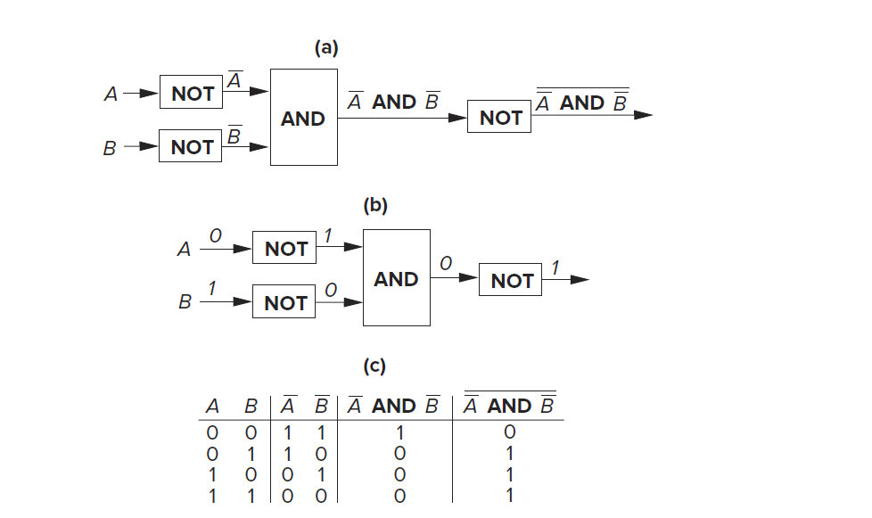
DeMorgan’s Laws

